Slide 1

Multiple Hypothesis Algorithm
Pravin Kumar Rana
Sound and Image Processing Lab.(SIP)
KTH - Royal Institute of Technology
SE-10044 Stockholm, Sweden

Slide 2
Outline
Multiple Hypothesis Algorithm
Results

Slide 3
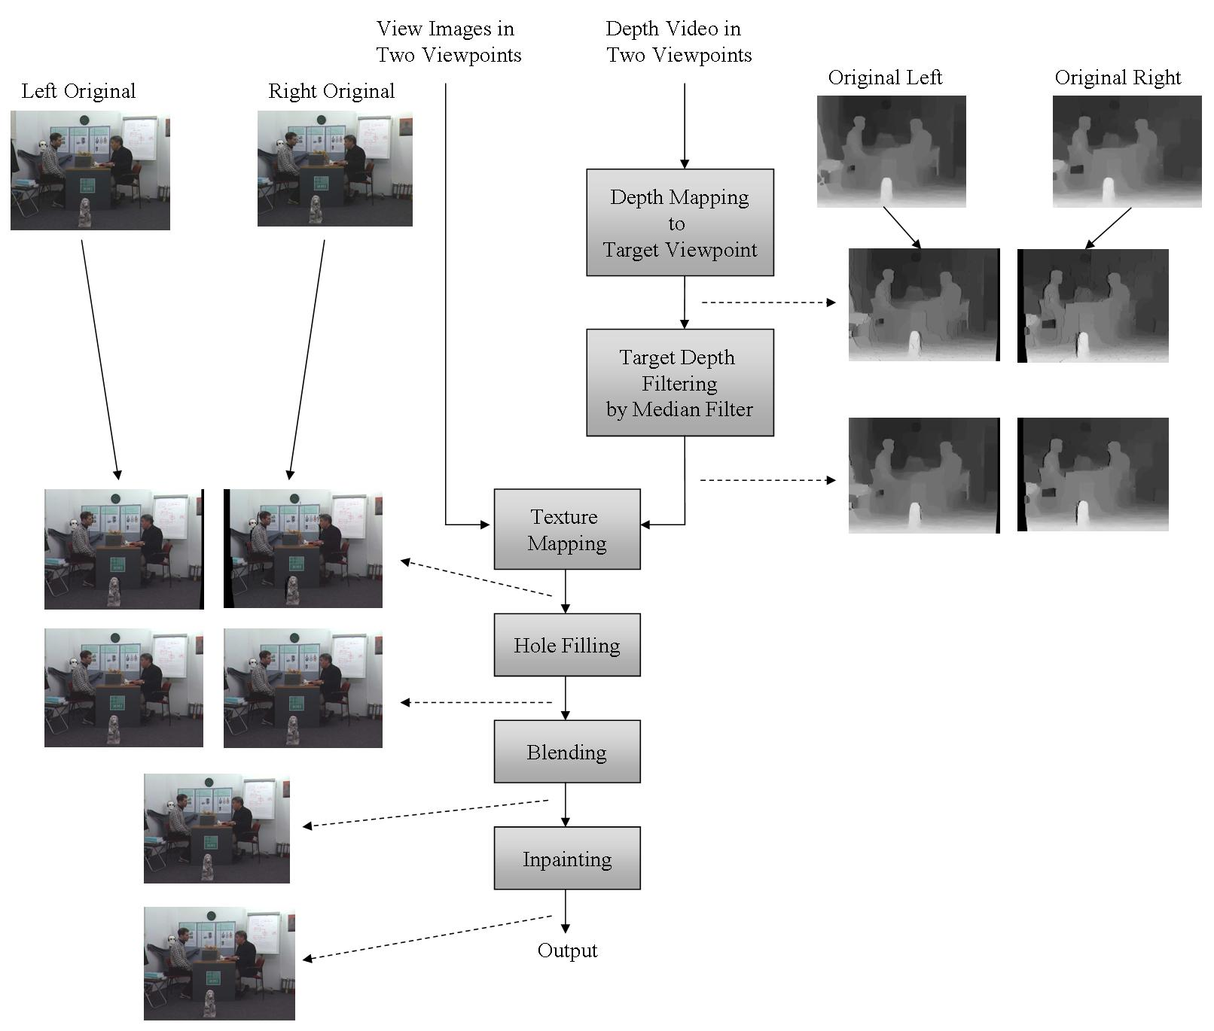
View Synthesis Reference Software

Slide 4



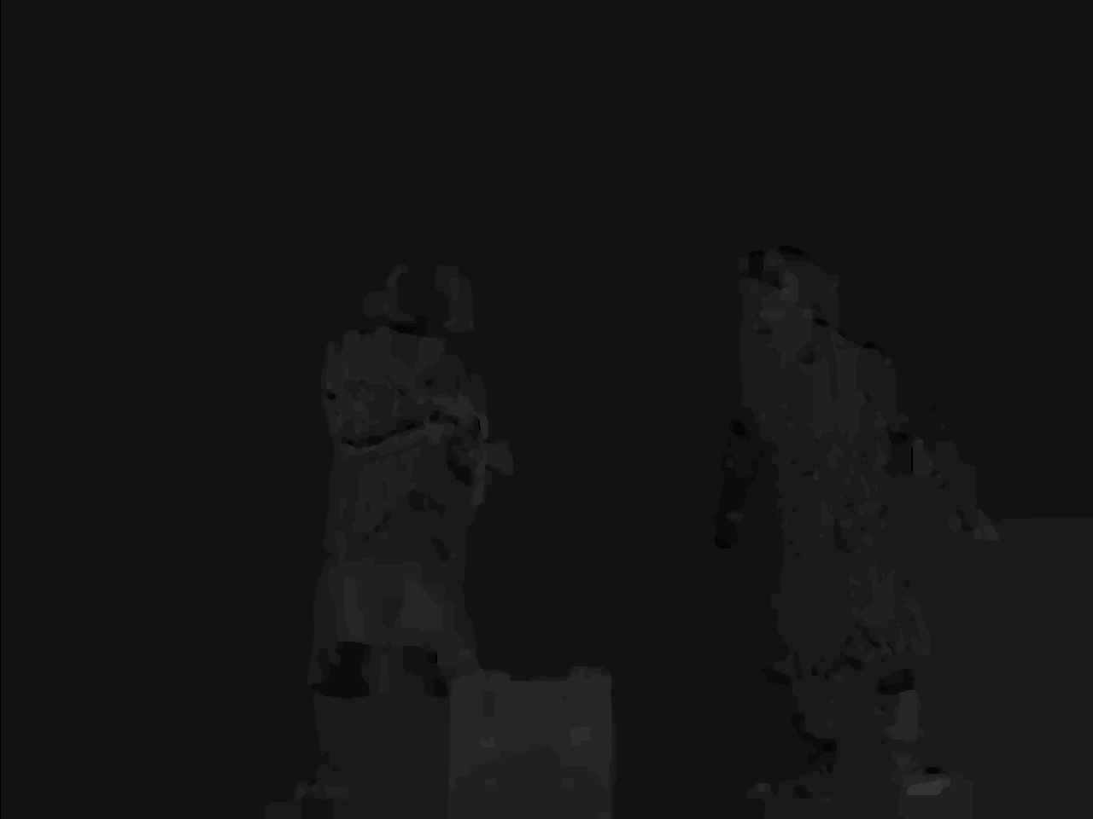
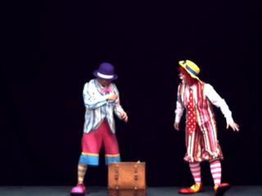
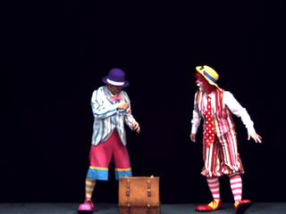
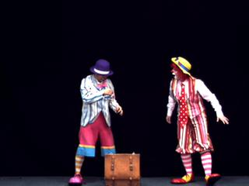
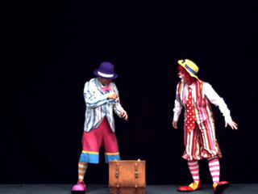
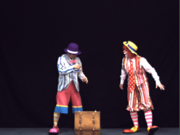
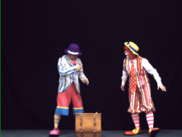

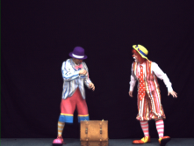
Multiple Hypothesis Algorithm
Depth Left Far Depth Left Near Depth Right Near Depth Right Far
Depth Mapping to Target Viewpoint
Original Left Far Original Left Near Original Right Near Original Right Far
Texture Mapping to Target Viewpoint
Virtual Depth 1 Virtual Depth 2 Virtual Depth 3 Virtual Depth 4
Virtual View 1 Virtual View 2 Virtual View 3 Virtual View 4

Slide 5
Absolute Depth Pixel Difference
Virtual Depth 1 Virtual Depth 2 Virtual Depth 3 Virtual Depth 4

Slide 6
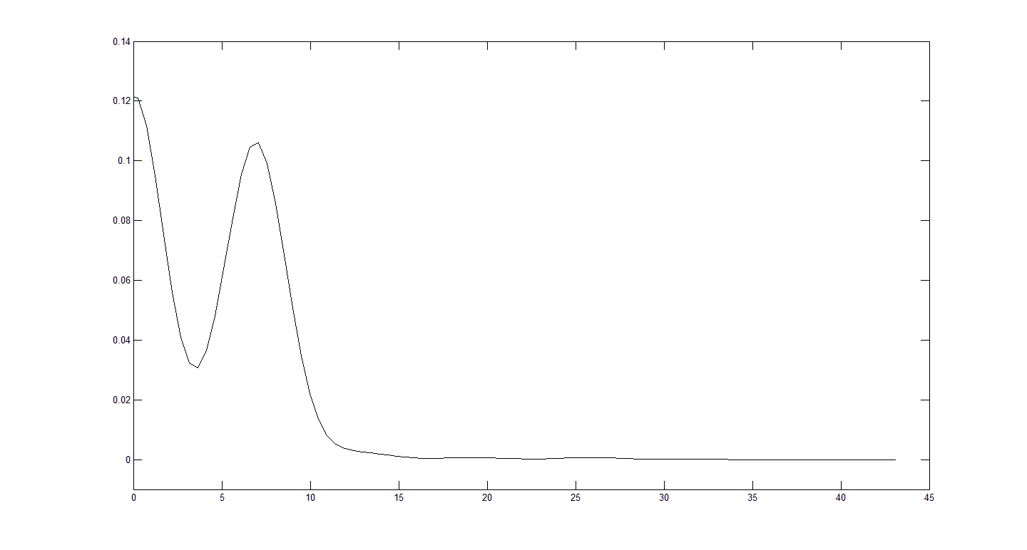
Distribution of Pixel Differences
Connecting Pixel Threshold
Absolute Pixel Difference

Slide 7
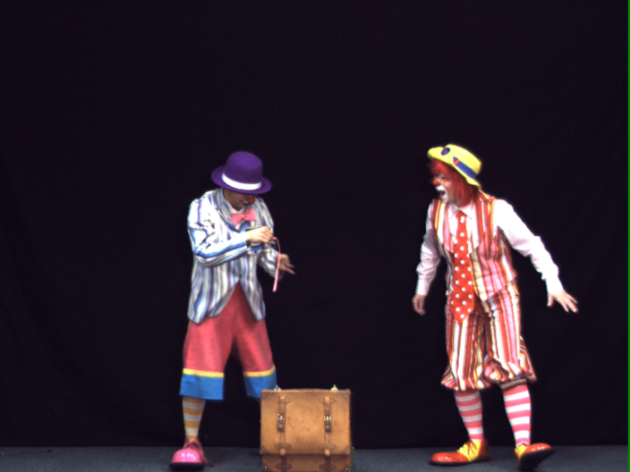
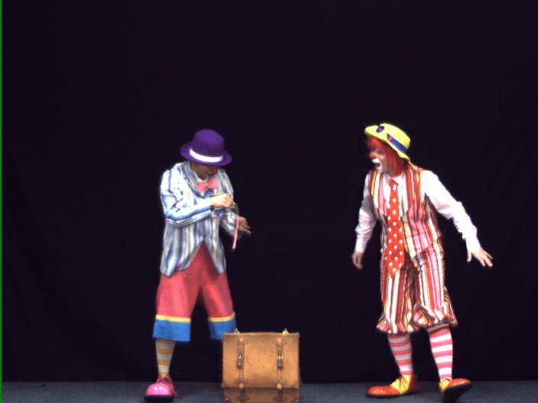


Case “1” : Two Hypothesis Case

Slide 8
Case “1” : Two Hypothesis Case
Virtual View 1 Virtual View 2 Virtual View 3 Virtual View 4
Virtual Depth 1 Virtual Depth 2 Virtual Depth 3 Virtual Depth 4

Slide 9
Case “2”
Virtual View 1 Virtual View 2 Virtual View 3 Virtual View 4
Virtual Depth 1 Virtual Depth 2 Virtual Depth 3 Virtual Depth 4

Slide 10
The Case “2”
Virtual View 1 Virtual View 2 Virtual View 3 Virtual View 4
Virtual Depth 1 Virtual Depth 2 Virtual Depth 3 Virtual Depth 4

Slide 11
Case “2”
Virtual View 1 Virtual View 2 Virtual View 3 Virtual View 4
Virtual Depth 1 Virtual Depth 2 Virtual Depth 3 Virtual Depth 4

Slide 12
Case “3” : Three Hypothesis
Virtual View 1 Virtual View 2 Virtual View 3 Virtual View 4
Virtual Depth 1 Virtual Depth 2 Virtual Depth 3 Virtual Depth 4

Slide 13
Case “3” : Three Hypothesis
Virtual View 1 Virtual View 2 Virtual View 3 Virtual View 4
Virtual Depth 1 Virtual Depth 2 Virtual Depth 3 Virtual Depth 4

Slide 14
Case “4” : Three or Four Hypothesis
Virtual View 1 Virtual View 2 Virtual View 3 Virtual View 4
Virtual Depth 1 Virtual Depth 2 Virtual Depth 3 Virtual Depth 4

Slide 15
Case “5” : Three or Four Hypothesis
Virtual View 1 Virtual View 2 Virtual View 3 Virtual View 4
Virtual Depth 1 Virtual Depth 2 Virtual Depth 3 Virtual Depth 4

Slide 16
Case “6” : Four Hypothesis
Virtual View 1 Virtual View 2 Virtual View 3 Virtual View 4
Virtual Depth 1 Virtual Depth 2 Virtual Depth 3 Virtual Depth 4
(All pixels are connected.)

Slide 17

Case “0” : Holes
Virtual View 1 Virtual View 2 Virtual View 3 Virtual View 4
Holes
Virtual Depth 1 Virtual Depth 2 Virtual Depth 3 Virtual Depth 4
X
X
X

Slide 18
Results
Pantomime Test Data
Frame Number | PSNR (dB)
 | View Synthesis Reference Software | Connecting Pixel Threshold = 0.0 | Connecting Pixel Threshold ≤6.0 | Connecting Pixel Threshold ≤7.0
1 | 39.8287 | 40.0432 | 40.2105 | 39.9007
2 | 39.6836 | 39.7855 | 40.2482 | 39.9031
3 | 39.9196 | 39.5292 | 40.2871 | 40.0056
4 | 40.0300 | 39.9476 | 40.3326 | 40.0549
Average | 39.8655 | 39. 8264 | 40.2696 | 39.9660

Slide 19
Pixel Connections & Cases
Frame 1 Frame 2 Frame 3 Frame 4
Connecting Pixel Threshold =0

Slide 20
Pixel Connections & Cases
Frame 1 Frame 2 Frame 3 Frame 4
Connecting Pixel Threshold ≤6

Slide 21
Pixel Connections & Cases
Connecting Pixel Threshold ≤ 7

Slide 22

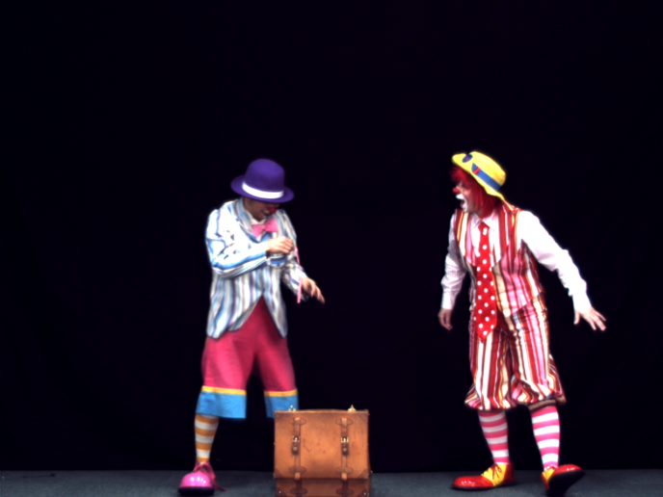


Synthesized Virtual Views
(a) Frame #01 (d)Frame #02
(C) Frame #03 (d)Frame #04
(Synthesized “Pantomime” view 40)

Slide 23
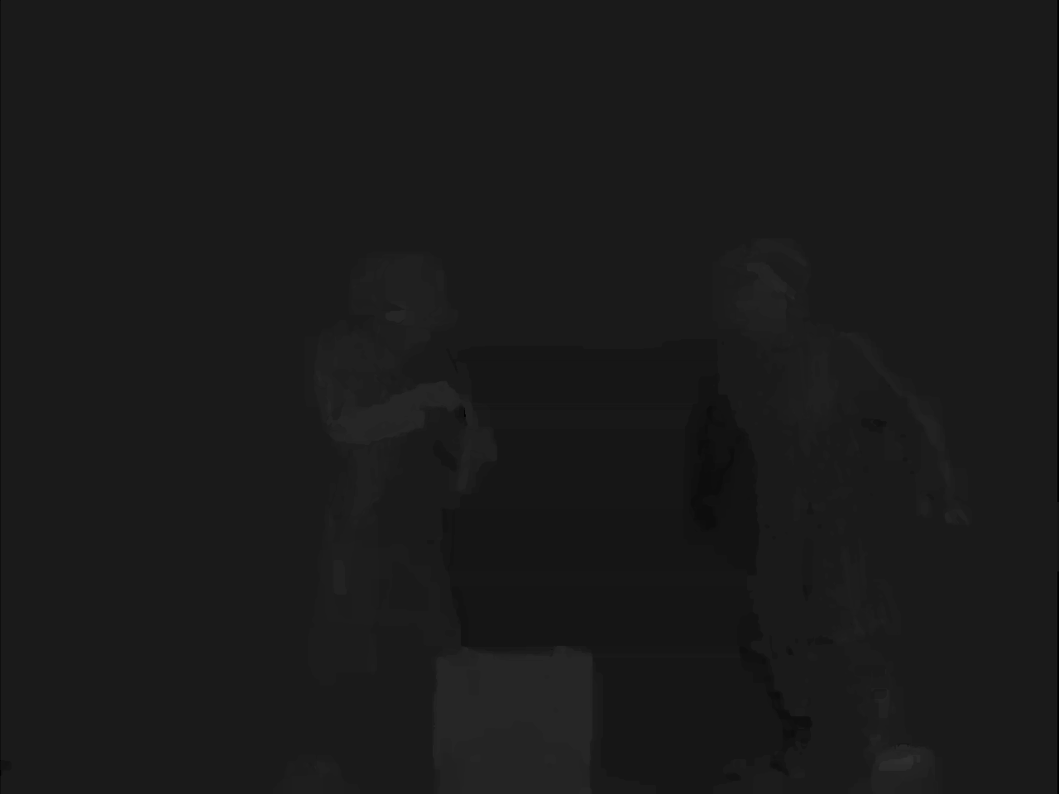
Depth Maps @ Virtual Position
(a) Left Far (d) Left Near
(e) Virtual Depth using MHA
(a) Right Near (d) Right Far

Slide 24
Views @ Virtual Position
(a) Left Far (d) Left Near
(C) Right Near (d) Right Far

Slide 25
Pixel Connections & Cases

